Slide 1
Camp Lejeune Litigation – Client Update
Baird Mandalas Brockstedt Federico & Cardea, LLC
February 15, 2023
12:00 PM (EST)

Slide 2
Introduction To Our Team
Legal Team and Our Co-Counsel
Military Advisory Board
Medical Advisory Board
Veterans Organizations’ Entrustments: VFW, NERA, ROA

Slide 3
Speakers
Philip C. Federico
Baird Mandalas Brockstedt Federico & Cardea, LLC
Janet Ward Black
Ward Black Law
Guy D. Smith
Greene Crow & Smith
Lacee B. Smith
Moeller PA
Dr. Craig H. Llewellyn
M.D. M.P.H., MSTMH, FACPM,
Col. Medical Corps,
U.S. Amy (Ret)
Jason E. Johns
Johns Law Office

Slide 4
Review of the Case
1953 – 1987: massive contamination of water at Camp Lejeune occurred resulting in the base becoming one of the worst public health disasters in our nation’s history.
2009: claims stemming from groundwater contamination were filed, but ultimately rejected due to federal government immunity and NC’s 10-year statute of limitations on bringing PI claims.
8/10/22: bipartisan Camp Lejeune Justice Act of 2022 was rolled into the PACT Act, was passed into law. The passage of this bill allows service members and their families, as well as civilian contractors, to file lawsuits stemming from groundwater contamination at Camp Lejeune.

Slide 5
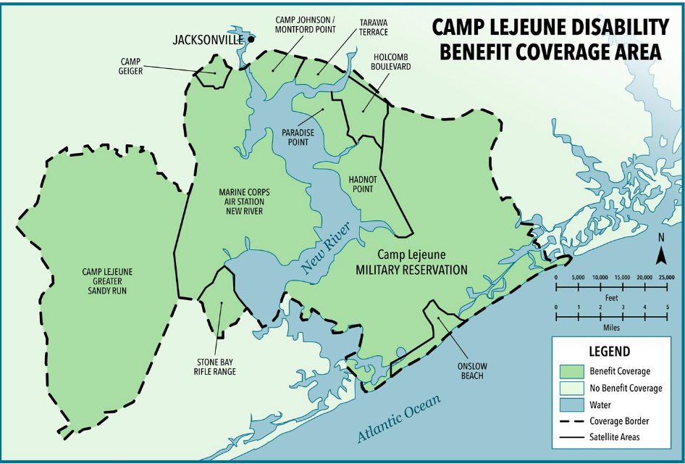

Slide 6
Pursuing a Claim
Step 1: File an administrative claim with the US Navy JAG
6 months to approve or deny your claim
An expressly denied claim, or no action taken in 6 months (considered effectively denied)
Step 2: Right to appeal denial by filing a lawsuit in U.S. District Court for the Eastern District of North Carolina.
Award: If case proven, you will receive either of: (1) amount of damages sought via administrative claim; (2) settlement award amount as set forth for your specific condition(s); (3) court award after winning one of the bellwether trials.
**NEXUS (Causation): Although the government has accepted liability, you still need to prove that your condition is linked to exposure to the groundwater at Camp Lejeune. There is no “presumption” in a court of law and strategically applying medical & scientific evidence will be important. This is why it is vital to be represented by a legal team experienced with environmental law and groundwater contamination torts.

Slide 7
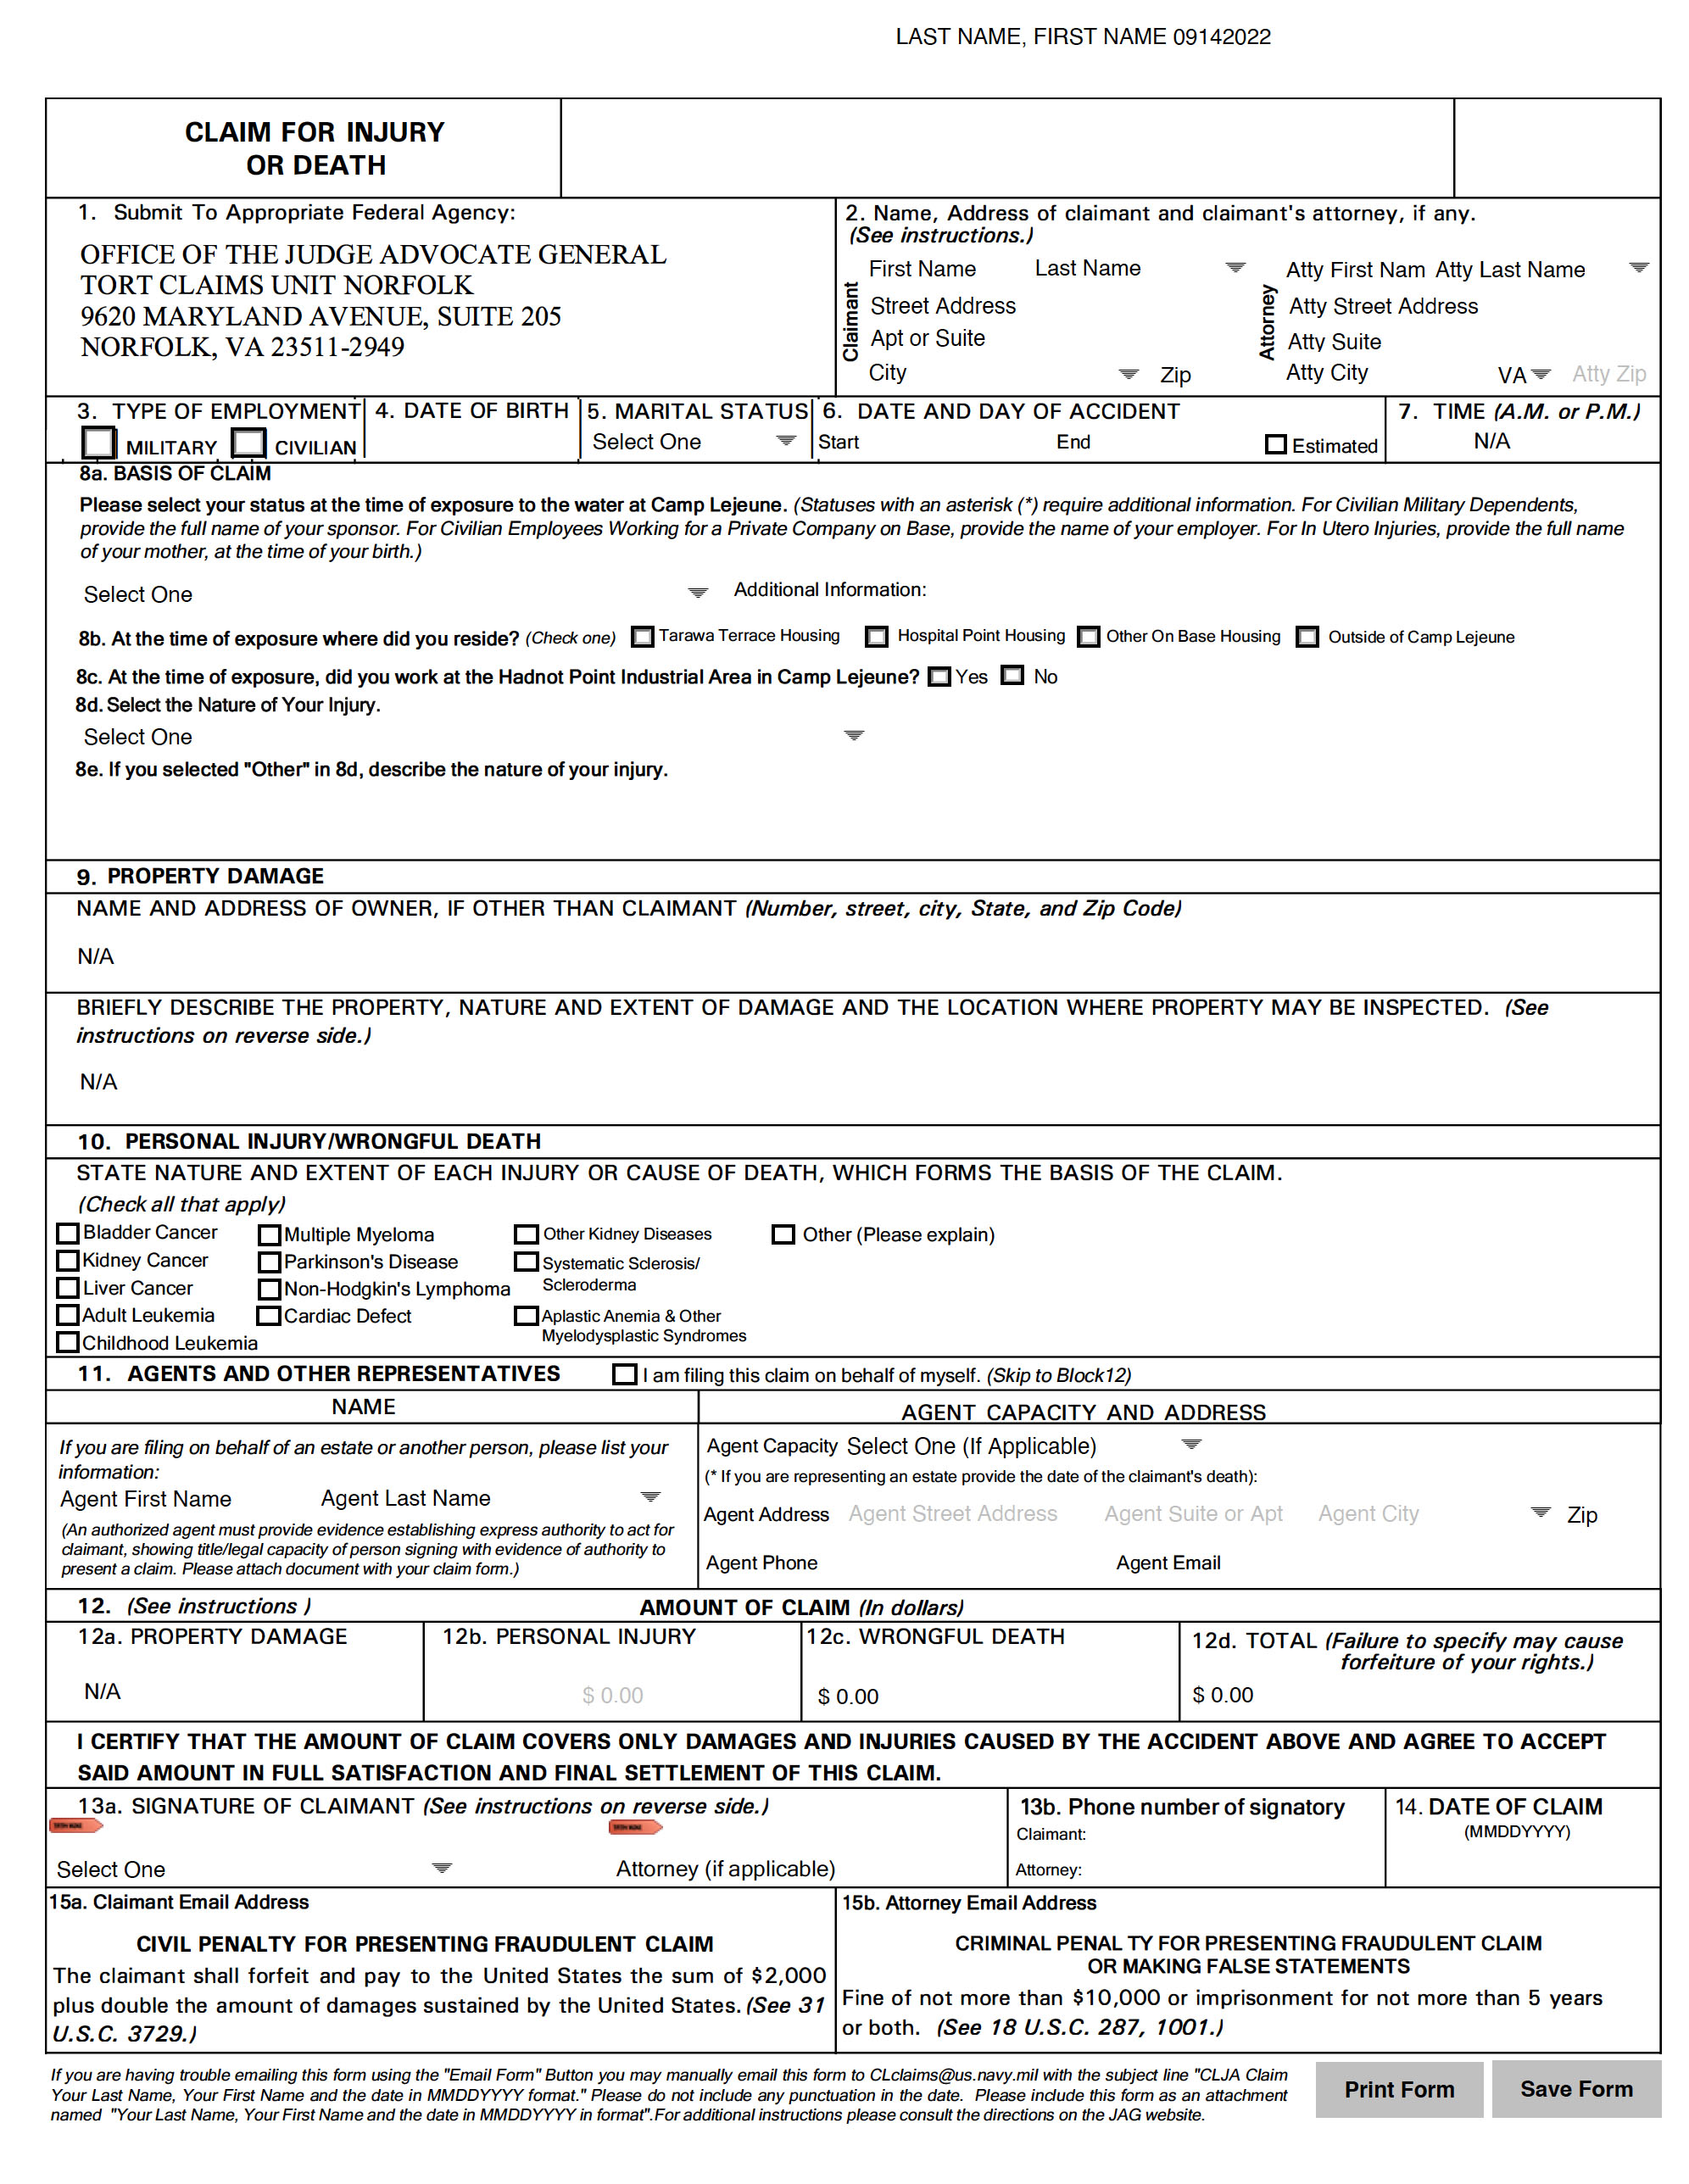
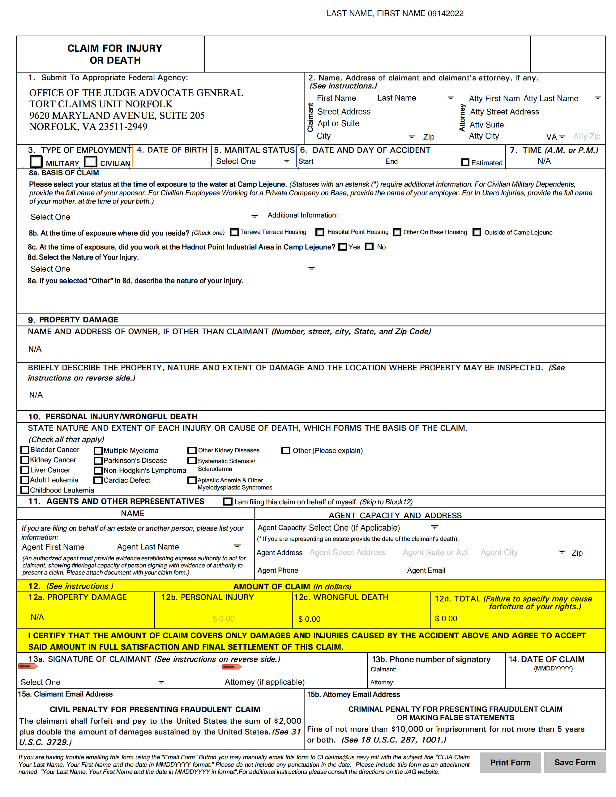
CLJA Claim Process
See US Code 2675, limiting the amount recoverable in an action to the amount of the claim presented to the federal agency, except where the increased amount is based upon newly discovered evidence...
Notes:
Bottom left corner – box “CLJA Form and Procedures are attached as an Exhibit.” Note-”Amount of Claim section.” Highlight ”amount of claim” and call it out.

Slide 8
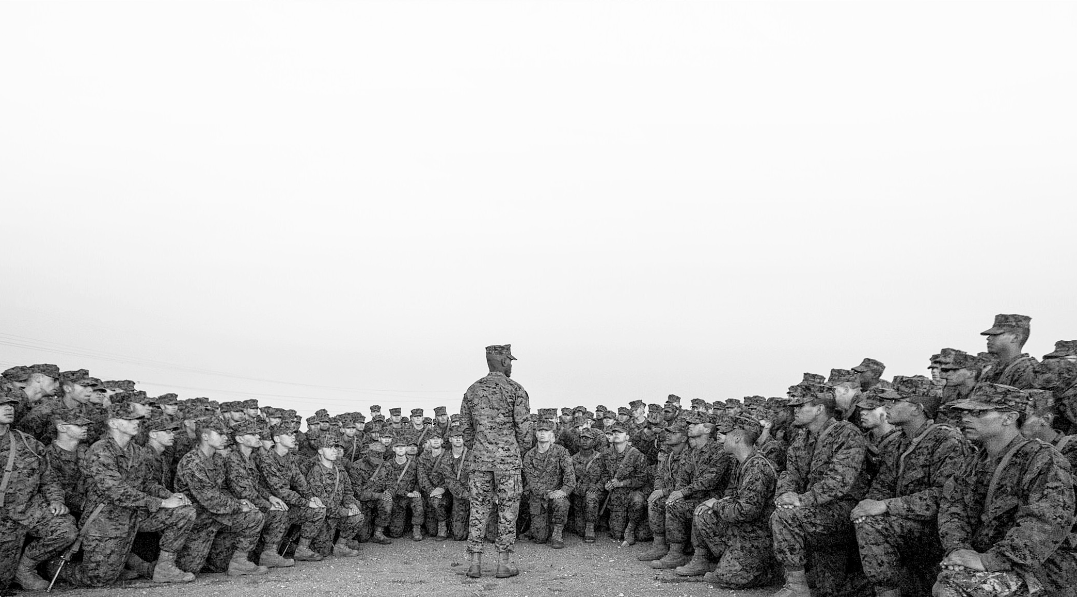
Deadlines
Section 804 (j)- Statute of Limitations
(2) STATUTE OF LIMITATIONS.—A claim in an action under this section may not be commenced after the later of—
(A) the date that is two years after the date of enactment of this Act; or
(B) the date that is 180 days after the date on which the claim is denied under section 2675 of title 28, United States Code.
Our position is that you may file an administrative claim up until 8-10-2024

Slide 9
Strategy Regarding When to File
The importance of selecting the best cases for bellwether trials:
The goal in the filing of initial cases is to limit the pool of those claims to the cases that involve the clearest and strongest causation, as well as the most severe damages associated with recognized health conditions.
If we achieve our goal, we will maximize the value of each case for each of the recognized health conditions.
The danger associated with filing weaker claims early on could result in bellwether cases that establish a lower floor for each category of damages.

Slide 10
PACT Act Sec. 804
804(b) - In General
“In General.—An individual, including a veteran (as defined in section 101 of title 38, United States Code), or the legal representative of such an individual, who resided, worked, or was otherwise exposed (including in utero exposure) for not less than 30 days during the period beginning on August 1, 1953, and ending on December 31, 1987, to water at Camp Lejeune, North Carolina, that was supplied by, or on behalf of, the United States may bring an action in the United States District Court for the Eastern District of North Carolina to obtain appropriate relief for harm that was caused by exposure to the water at Camp Lejeune.”

Slide 11
PACT Act Sec. 804
804(c ) - Burden and Standard of Proof
(1) “IN GENERAL.—The burden of proof shall be on the party filing the action to show one or more relationships between the water at Camp Lejeune and the harm.”
(2) “STANDARDS.—To meet the burden of proof described in paragraph (1), a party shall produce evidence showing that the relationship between exposure to the water at Camp Lejeune and the harm is—”
(A) “sufficient to conclude that a causal relationship exists; or”
(B) “sufficient to conclude that a causal relationship is at least as likely as not.”

Slide 12
Where to File
Exclusive Jurisdiction And Venue.—The United States District Court for the Eastern District of North Carolina shall have exclusive jurisdiction over any action filed under subsection (b), and shall be the exclusive venue for such an action.
Impressions of the Eastern District of North Carolina

Slide 13
Not A Class Action
Individual treatment of each case.
Your specific exposure at Camp Lejeune
Your specific conditions
Your individual damages

Slide 14
The Discovery Phase of the Lawsuit
Initial Disclosures
Written Discovery
Fact Depositions
Rule 26 Expert Reports
Expert Depositions
Settlement Negotiations
Trial

Slide 15
Exposure to Pollutants
Step 1: Proving you were exposed to the contaminated water.
Exposure to water from one of the contaminated supply sources, to include, e.g. consumption of on base drinking water, frequency of consumption or other exposure.
Hot spot locations of contamination: Hadnot Point (Contaminated since 1942); Tarawa Terrace (contaminated since 1952); Holcomb Blvd (1972-1985).
Step 2: Proving that the water to which the Plaintiff was exposed was actually contaminated with relevant pollutant at the time of exposure at levels sufficient to yield health effects.
We will be utilizing the expertise of hydrogeologists, scientists, and medical experts, among others, to link your exposure to your health conditions.

Slide 16
Establishing Proof of Harm/Injury
Causation:
General Causation: the substance(s) is/are capable of causing a specific disease in humans
Specific Causation: the particular substance caused the plaintiff’s injury
Economic Damages:
Specialized medical experts to testify regarding future prognosis, necessity for treatment and medical monitoring, and costs of future treatment.
Utilization of lifecare planner for purposes of future care needs.
Potential need for vocational rehabilitation expert to address possible lost wage claim.
Need for economist to reduce economic damages to present value.

Slide 17
Prospects for Resolution
Unclear what direction this litigation will take.
Given extent of potential exposure, significant likelihood that issues of causation will need to be resolved by Court in high stakes hearings/trials.
Important to have organized approached to the litigation as a whole to ensure the highest quality presentation of evidence in early cases.

Slide 18
Death Claims and Estate Issues
Non-NC resident estates can be filed in Onslow County, NC since the harm occurred at Camp Lejeune.
Filing requirements for estates will depend on (1) whether decedent had a will; (2) whether decedent was NC resident; and (3) whether an estate was previously administered for the decedent.
All estates should be administered as wrongful death claims. Three benefits: (1) no bond required; (2) no notice to creditors required; and (3) wrongful death awards do not flow through the estate, so no probate fees have to be paid on the award.
Note: All estate filings will require original signatures and many documents will need to be signed before a notary public. We often send pre-paid envelopes to clients for ease of return of original executed documents.

Slide 19
5 Estate Scenarios
Scenario 1: NC resident at time of death, died with will, and will was probated in NC County
Scenario 2: NC resident at time of death, died with will, and no estate administered
Scenario 3: NC resident at time of death, no will, and no estate administered
Scenario 4: Non-NC resident at time of death, died with will, estate administered
Scenario 5: Non-NC resident at time of death, no will, and no estate administered

Slide 20
Offset and Your Benefits
Under the CLJA: Any award shall be offset by the amount of any disability award, payment, or benefit provided to the individual or legal representative under VA programs, Medicare, and Medicaid.
CANNOT offset benefits to conditions not service-connected to Camp Lejeune exposure.
The U.S. Department of Veterans Affairs has issued guidance stating the amount of any disability award, payment, or benefit received for a condition related to Camp Lejeune will only reduce the amount of the award and will NOT:
Reduce rating percentage or monthly compensation
Affect eligibility for other VA benefits or services
Influence the VA’s decision to provide benefits or healthcare based upon your exposure or the amount of compensation you receive from the VA
Affect the amount of benefits or healthcare the VA provides to you now or in the future

Slide 21
Camp Lejeune Claims vs. VA Claims
Separate Lanes - May pursue a Camp Lejeune legal claim and VA benefit simultaneously.
VA benefits eligibility vs. Camp Lejeune legal claim
If you have not applied for VA benefits, you are encouraged to reach out to your local VFW Service Officer, and we are happy to help you do so.

Slide 22
Review of Health Conditions
Tier 1 | Tier 2 | Tier 3
VA Presumptive Conditions Adult leukemia Aplastic anemia and other myelodysplastic syndromes Bladder cancer Kidney cancer Liver cancer Multiple myeloma Non-Hodgkin’s lymphoma Parkinson’s disease Other Equipoise or above conditions Birth defects Breast cancer Cardiac Birth Defects Esophageal cancer Female infertility Hepatic steatosis Kidney diseases Leukemia Lung cancer Miscarriage Neurobehavioral effects Renal toxicity Scleroderma | Pancreatic Cancer Prostate Cancer Rectal Cancer Brain/CNS Cancer Other serious, chronic, or life-threatening cancer or condition | Other conditions or diseases
Camp Lejeune Condition Tiers
Tier 1: VA Presumptive and/or “Equipoise and Above” in ATSDR Report
Tier 2: Possibly associated deceases but below equipoise ATSDR findings
Tier 3: Unlikely related but diagnosed condition
Tier 4: No diagnosed conditions but meets exposure qualifications

Slide 23
Review of Health Condition “Tiers”
Tier 1: VA Presumptive and/or “Equipoise and Above” in the ATSDR Report
Tier 2: Possibly associated diseases but below equipoise ATSDR findings
Tier 3: Unlikely related but diagnosed condition
Tier 4: No diagnosed conditions as of Aug 10th, 2022, but meet exposure qualifications

Slide 24
What to Expect
Not a one-off case, and it is going to move slowly.
When you will be contacted by us:
Medical and Military Record Inquiries
Death claim and estate Inquiries
Claim-related inquiries
Status letter every 60 days (next one March 15)
Quarterly Zoom webinar (next one in June)
In addition to your referring attorney, please contact our office anytime at (443) 256-4994 or camplejeune@bmbfclaw.com.

Slide 25
Why the VFW Entrusts BMBFC Law
Our team is entrusted by the VFW because of our depth of experience in groundwater contamination cases and our core commitment to doing right by veterans and their families throughout the process, including:
25% contingency fee.
No upfront costs or fees.
We coordinate with the VFW to assure veterans & surviving spouses have applied for all VA benefits they are eligible for.
Ultimate decision is UP TO YOU. When/If an award is offered, we will review it in-depth to assure it does not impact your benefits and makes financial sense. If it does not, we turn it down. With no cost out of-pocket to you, and nothing changing with your benefits.

Slide 26
Questions?

